Slide 1
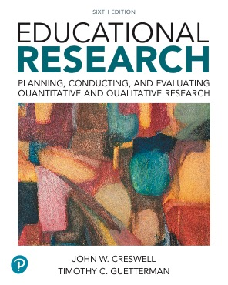
Educational Research: Planning, Conducting, and Evaluating Quantitative and Qualitative Research
Sixth Edition
Chapter 10
Experimental Designs
Copyright © 2019, 2015, 2012 Pearson Education, Inc. All Rights Reserved
Notes:
If this PowerPoint presentation contains mathematical equations, you may need to check that your computer has the following installed:
1) MathType Plugin
2) Math Player (free versions available)
3) NVDA Reader (free versions available)

Slide 2
What is an Experiment?
In an experiment, you test an idea (or practice or procedure) to determine whether it influences an outcome or dependent variable
Experimental design process
  Decide on idea with which to experiment
  Assign individuals to experience it (and have some experience something different)
  Determine whether those who experienced the idea (or practice or procedure) performed better on some outcome than those who did not experience

Slide 3
What is an Experiment, When Should You Use It, and How Did It Develop?
When Did Experiments Develop?
Psychological experiments (late 19th, early 20th century)
Procedures for comparing groups (McCall, 1925)
Statistics for comparing groups (e.g., chi-square)
Identification of types of experimental designs (Campbell and Stanley,1963)
Types of basic designs and threats (Cook and Campbell, 1979)
Complicated experiments with many variables (since 1980)
Observational studies (Rosenbaum, 2002)

Slide 4
What Are Key Characteristics of Experiments?
Random assignment
Control over extraneous variables
Manipulation of the treatment conditions
Outcome measures
Group comparisons
Threats to validity

Slide 5
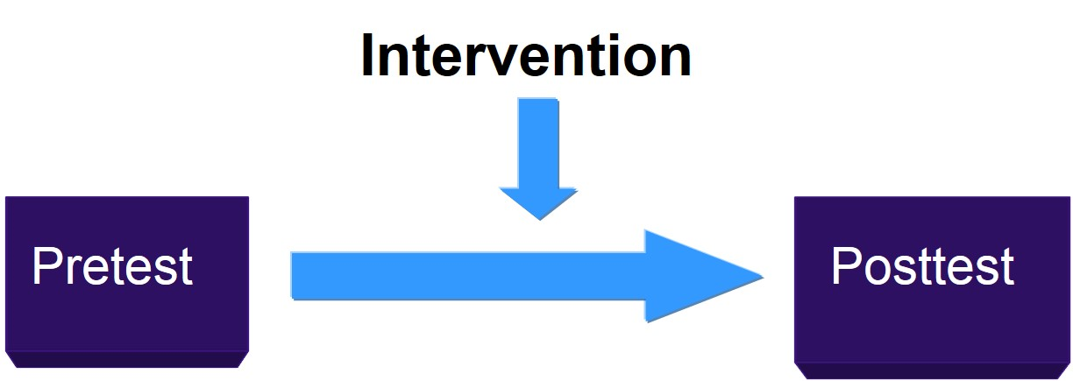
Pretests and Posttests

Slide 6
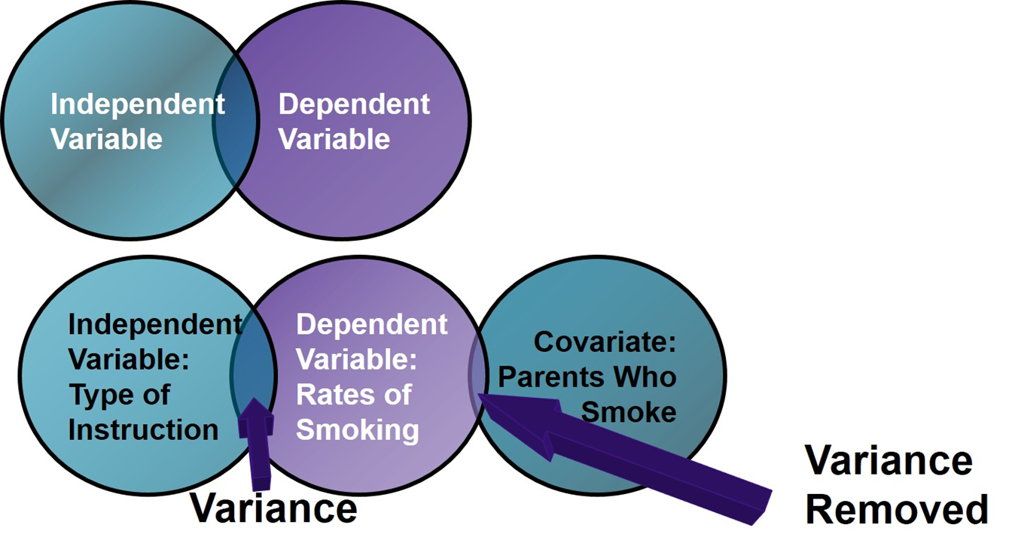
Figure 10.1 Controlling for Covariate

Slide 7
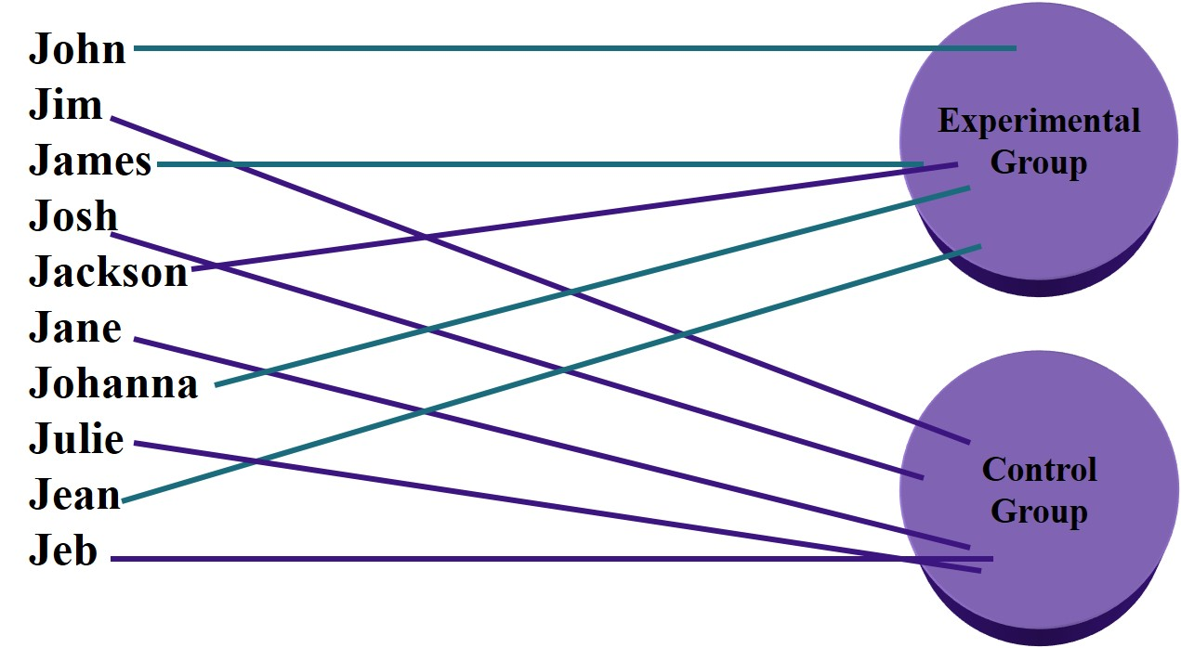
Figure 10.2 The Matching Process Based on Gender

Slide 8
Figure 10.3 Experimental Manipulation of a Treatment Condition
Independent variables
Age (cannot manipulate)
Gender (cannot manipulate)
Types of instruction (can manipulate)
Dependent variable
Frequency of smoking
  a. Lecture (control)
  b. Lecture + hazard discussion (comparison)
  c. Lecture + hazard discussion + slides of damaged lungs (experimental)

Slide 9
What Are Key Characteristics of Experiments?
Outcome Measures
Outcome is dependent variable (also called response, criterion, posttest)
Presumed effect of treatment variable
Need to be responsive and valid measure
Examples
  Achievement test scores
  Aptitude test scores
  Mental health assessment scores

Slide 10
What Are Key Characteristics of Experiments? (14 of 17)
Threats to Validity
Specific reasons for why we can be wrong when we make an inference in an experiment
  Statistical conclusion validity
  Construct validity
  Internal validity
  External validity

Slide 11
What Are the Types of Experimental Design?
Between Group designs
True experiments (pre- and posttest, posttest only)
Quasi-experiments (pre- and posttest, posttest only)
Causal comparative research
Factorial designs
Within-group or individual designs
Time-series (interrupted, equivalent)
Repeated measure
Single subject

Slide 12
Educational Research: Planning, Conducting, and Evaluating Quantitative and Qualitative Research
Sixth Edition
Chapter 11
Correlational Designs
Copyright © 2019, 2015, 2012 Pearson Education, Inc. All Rights Reserved
Notes:
If this PowerPoint presentation contains mathematical equations, you may need to check that your computer has the following installed:
1) MathType Plugin
2) Math Player (free versions available)
3) NVDA Reader (free versions available)

Slide 13
What is Correlational Research, When Do You Use It, and How Did It Develop?
In correlational research designs, investigators use the correlation statistical test to describe and measure the degree of association (or relationship) between two or more variables or sets of scores
Product-moment correlation coefficient: statistic that expresses linear relationships

Slide 14
What is Correlational Research, When Do You Use It, and How Did It Develop?
How Did Correlational Research Develop?
1895 Pearson develops correlation formula.
1897 Yule develops solutions for correlating two, three, and four variables.
1935 Fisher pioneered significance testing and analysis of variance.
1963 Campbell and Stanley write about experimental and quasi-experimental designs (including correlational designs).
1970s and 1980s computers give the ability to statistically control variables and do multiple regression.

Slide 15
What are the Key Characteristics of Correlational Designs
Associations between Scores: What Is the Direction of the Association?
Direction
  Positive correlation (“+” correlation coefficient) means points move in the same direction
  Negative correlation (“-” correlation coefficient) means points move in the opposite direction
If scores do note relate in a pattern, no linear association

Slide 16
What are the Key Characteristics of Correlational Designs
Associations between Scores: What Is the Form of the Association?
Positive linear relationship: low (or high) scores on one variable relate to low (or high) scores on a second variable
Negative linear relationship: low scores on one variable relate to high sores on a second variable
Curvilinear (or nonlinear): a U-shaped relationship of scores

Slide 17
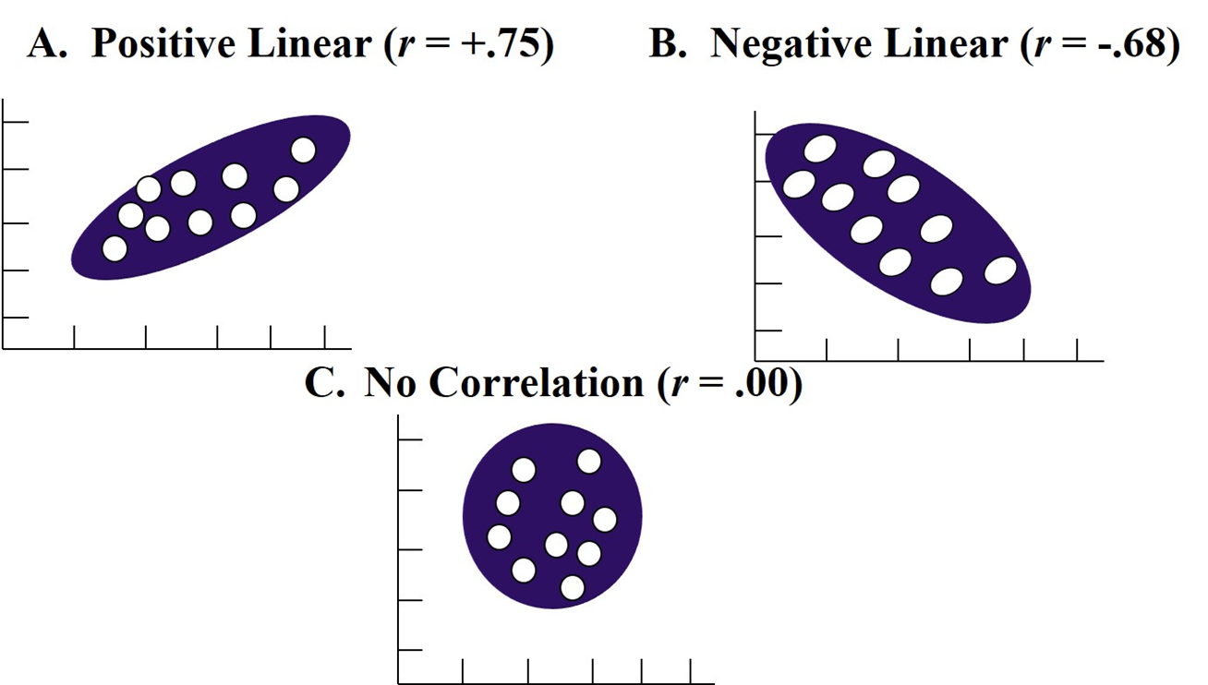
Figure 11.1 Patterns of Association between Two Variables

Slide 18
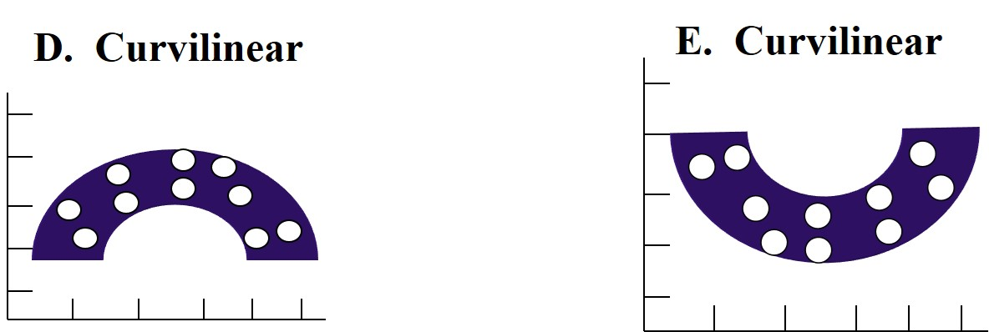
Linear and Nonlinear Patterns

Slide 19

What are the Key Characteristics of Correlational Designs
Associations between Scores: What Are the Degree and Strength of Association?
Degree and strength (size of coefficient)
  From −1.0 to +1.0
  0 indicates no correlation
  Valence sign (+ or −) indicates direction
Coefficient of determination: proportion of variance in one variable that can be explained by the other

Slide 20
What are the Key Characteristics of Correlational Designs
Associations between Scores: What Are the Degree and Strength of Association?
.20–.35: only a slight relationship
.35–.65: useful for limited prediction
.66–.85: good prediction can result from one variable to the other, considered very good
.86 and above: high correlation, typically achieved for studies of construct validity or test-retest reliability

Slide 21
Potential Ethical Issues in Conducting Correlational Research
Not measuring appropriate controls
Not having a sufficient sample size and meeting the assumptions of the statistic
Making up or editing data
Stating cause and effect when data show patterns of relationships
Not reporting effect sizes or significance testing
Plagiarizing others
Not reporting contradictory findings
Not sharing data reports with others

Slide 22
Educational Research: Planning, Conducting, and Evaluating Quantitative and Qualitative Research
Sixth Edition
Chapter 12
Survey Designs
Copyright © 2019, 2015, 2012 Pearson Education, Inc. All Rights Reserved
Notes:
If this PowerPoint presentation contains mathematical equations, you may need to check that your computer has the following installed:
1) MathType Plugin
2) Math Player (free versions available)
3) NVDA Reader (free versions available)

Slide 23
What is Survey Research, When Do You Use It, and How Did It Develop? (1 of 3)
Survey research designs are procedures in quantitative research in which investigators administer a survey to a sample or to the entire population of people in order to describe the attitudes, opinions, behaviors, or characteristics of the population.

Slide 24
What is Survey Research, When Do You Use It, and How Did It Develop? (2 of 3)
When Do You Use Survey Research?
To assess trends
To assess opinions, beliefs, and attitudes of individuals
For follow-up analyses
For program evaluation

Slide 25
What is Survey Research, When Do You Use It, and How Did It Develop? (3 of 3)
How Did Survey Research Develop?
1817 International Survey of Education Systems
1890 Stanley Hall survey of children
1907 The Pittsburgh Survey examined social problems
W W I and W W II sampling techniques improved
Wide applications in social sciences-marketing research, public opinion research, journalism
Universities established social science research centers
Private organizations such as Gallup, Rand Corporation, and Roper formed
Internet-based surveys widely used

Slide 26
What Are the Types of Survey Design? (1 of 5)
Cross-Sectional Survey Designs
Researcher collects data at one point in time
Measures current attitudes, beliefs, opinions, or practices
Provides information in short amount of time
Examples:
  Compare groups, such as students with teachers or different settings
  Measure community needs
  Evaluate a program by asking about perceptions
  Gather a national survey with 1000s

Slide 27
What Are the Types of Survey Design? (2 of 5)
Longitudinal Survey Designs
Collect data over time
Used to understand
  Trends with the same population
  Changes in a cohort group or subpopulation
  Changes in a panel group of the same individuals over time
  Example: follow-up about how views change over time

Slide 28
What Are the Types of Survey Design? (3 of 5)
Longitudinal Survey Designs: Trend Studies
Identify a population and examine changes over time
Assess how trends change
Example: the Gallup Poll monitors voters during elections

Slide 29
What Are the Types of Survey Design? (4 of 5)
Longitudinal Survey Designs: Cohort Studies
Identify a subpopulation (cohort) based on a characteristic
Study that subpopulation over time
Example:
  Study a cohort of 18-year olds in 2017
  Five years later, study a group of 23-year olds (may not be the same individuals)
  Continue over time as long as individuals were 18 in 2017

Slide 30
What Are the Types of Survey Design? (5 of 5)
Longitudinal Survey Designs: Panel Studies
Examine the same people (i.e., panel) over time
Advantage is the ability to determine actual changes in specific individuals
Disadvantage is that people may be difficult to locate
Example:
  Study a graduating class in 2017, follow the exact same individuals at 1 year, 2 years, 5 years, etc.
  Might also compare groups

Slide 31
What Are the Key Characteristics of Survey Research?
Sampling from a population
Collecting data through questionnaires or interviews
Designing instruments for data collection
Obtaining a high response rate

Slide 32
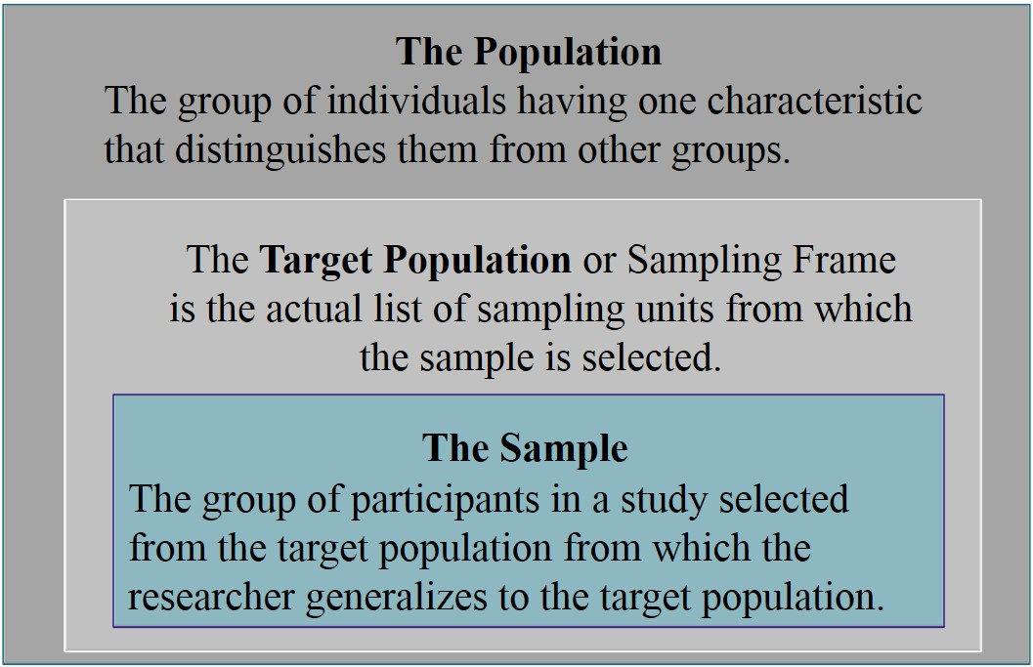
Figure 12.2 Differences between the Population, Target Population or Sampling Frame, and Sample

Slide 33
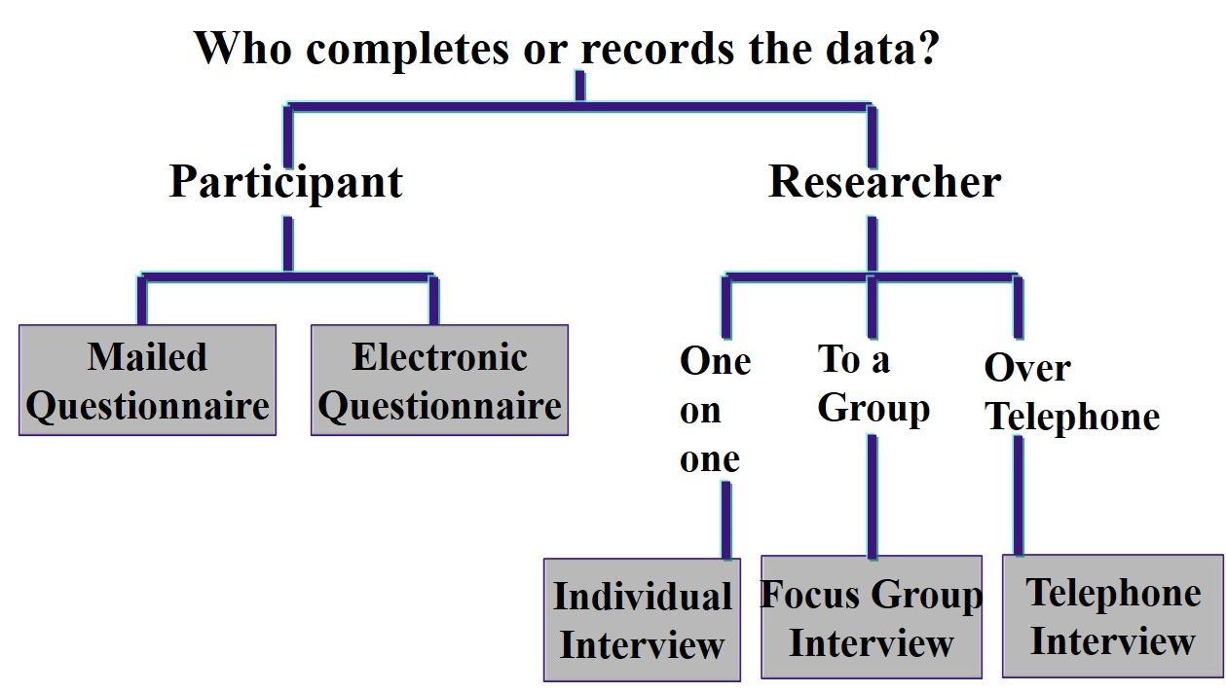
Figure 12.3 Forms of Data Collection to Survey Research

Slide 34
What Are the Key Characteristics of Survey Research?
Response Rate: Response Bias
The responses do not accurately reflect the views of the sample and the population.
  Overly positive or negative
Assess response bias, particularly when response rates remain low
Wave analysis: procedure to check for response bias in which investigators group returns by intervals

Slide 35
What Are the Key Characteristics of Survey Research?
Response Rate: Response Set
Participants tend to respond in a certain way to more than one question that does not reflect their true beliefs
Examples:
  Always rate “strongly agree” because quickly responding and not reading questions carefully
  Respond because it seems that is what the researcher wants to hear
  Give socially acceptable responses

Slide 36
What Are Potential Ethical Issues in Survey Research?
Overstating the benefits of participating in the study
Placing interviewers or participants in unsafe situations
Protecting confidentiality of survey responses
Disclosing identity of individuals through data analysis of a subset
Not destroying instruments at the conclusion of the study

